Slide 1
Tennessee
Migrant Education Program
Comprehensive Overview

Slide 2
Agenda
What is the Tennessee Migrant Education Program (TN MEP)?
Who is eligible?
How do we find our students?
What is Arroyo Research Services (ARS) responsible for?

Slide 3
Alphabet Soup
MEP: Migrant Education Program
OSY: Out-of-School Youth
COE: Certificate of Eligibility
ID&R: Identification & Recruitment
MIS2000: also known as TNMigrant
MSIX: Migrant Student Information Exchange

Slide 4
What is the TN MEP?

Slide 5
The Migrant Education Program (MEP)
Title 1, Part C of the Elementary and Secondary Education Act (ESEA)
Enacted in 1965 and reauthorized as the Every Student Succeeds Act (ESSA)
The MEP is funded by the U.S. Department of Education and administered by the State Education Agencies (SEAs)
The Tennessee Department of Education (TDOE) distributes funds to Local Education Agencies (LEAs) across the state and to ARS in order to identify, recruit and serve all of the eligible migratory students in Tennessee.

Slide 6
Purpose of Tennessee MEP
The program aims to ensure that all migratory students reach challenging academic standards and graduate with a high school diploma (or complete the HiSET) that prepares them for responsible citizenship, further learning, and productive employment.

Slide 7
TN MEP Structure
Tennessee Department of Education
Arroyo Research Services (ARS)
Local Education Agencies (LEAs)
ID&R Team
Data Specialists
Migrant Liaisons
Parent Engagement & PAC
CNA/SDP/
Evaluation

Slide 8
TN MEP Structure 2023-24
147 Districts statewide
14 MEP-funded Districts
Data specialists
Services team
ID&R team
Parent Engagement & PAC
CNA/SDP/Evaluation team

Slide 9
TN MEP Structure
All Tennessee School Districts
Distribute and collect student surveys to identify potential migratory students
Provide data on migratory students for input into MSIX
Provide liaisons to support:
Recruitment of eligible migratory students in the district
Provision of services to eligible migratory students in the district

Slide 10
TN MEP Structure
14 MEP-Funded School Districts
Distribute and collect student surveys to identify potential migratory students
Provide information to the ID&R Team so they can contact potentially eligible migratory families and youth
Record data tied to the TN Service Delivery Plan Measurable Program Objectives
Participate in data trainings
Contact the ARS data team for help when needed

Slide 11
TN MEP Structure 2023-24
14 MEP-Funded School Districts
Bledsoe County
Cocke County
Davidson County
Hamilton County
Knox County
Lebanon Special
Lenoir City
Loudon County
Macon County
Putnam County
Rhea County
Robertson County
Shelby County
Sumner County

Slide 12
TN MEP Structure
Identification and & Recruitment (ID&R) Team
Interviews migratory families, children and youth to determine eligibility for the migrant education program
Develops working relationships with schools and community organizations to identify potentially eligible migratory families and youth
Provides initial support to assure eligible migratory children and youth are connected to educational and other services
TN MEP Recruiters
Aurora Calzada Egide Irambona, Alejandrina Rodriguez, Veronica Rosales, (also Jason Herrera, Mike Pentecost)

Slide 13
TN MEP Structure
Data Specialists
Collect data tied to the TN Service Delivery Plan
Use the federal Migrant Student Information Exchange (MSIX) and MIS2000 to collect student data and produce required reports
Implement the data reconciliation process between TN State database, MSIX, and MIS2000
Conduct training for LEAs and migrant staff on using MSIX, using the TN MEP secure server and the TN Migrant database
Provide technical assistance to LEAs and TN MEP staff
Verify and analyze data to report to the MEP State Director
TN MEP Data Specialists:
Elena Cruz and Odilia Coffta

Slide 14
TN MEP Structure
Field Services Leaders
Rachel Jackson and Karen Kearns (OSY)
Identify specific student and youth needs
Facilitate and/or coordinate advocacy to meet student/family needs
Network and collaborate with LEAs, community organizations and other programs (i.e., TN Migrant Health, Homeless Education)
Locate service providers to provide services not currently being offered
Facilitate connecting appropriate service providers with migratory families, children and youth
Coordinate ARS TN MEP team activities in the state

Slide 15
TN MEP Structure
ARS Parent Engagement-Michele Cheney
Conduct two statewide Parent Advisory Councils (PAC)
Provide training to LEAs on parent engagement and PAC
Survey parents about family engagement needs/wants
Conduct parent learning opportunities
Identify and disseminate resources and information on how parents can support their children’s learning

Slide 16
Who is eligible for the TN MEP?

Slide 17
Who is eligible?
Each migratory student must have a Certificate of Eligibility signed by TDOE to receive services
Some Eligibility Factors (each move is unique!)
Migratory – students, families and workers who moved across school district lines in past three years
Farmworker or Fisher - worked in these temporary or seasonal industries
Eligible for Free Public Education in the US - students have not yet reached age 22 or obtained a HS diploma or equivalent

Slide 18
Who is eligible?
Migratory – students, families and workers moved across school district lines in past three years

Slide 19
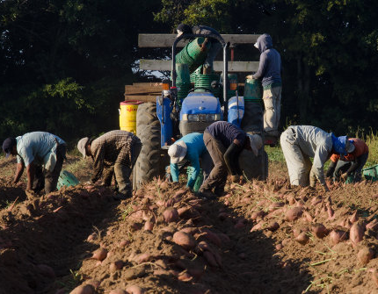
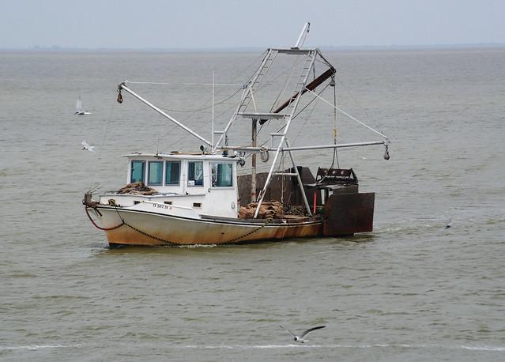
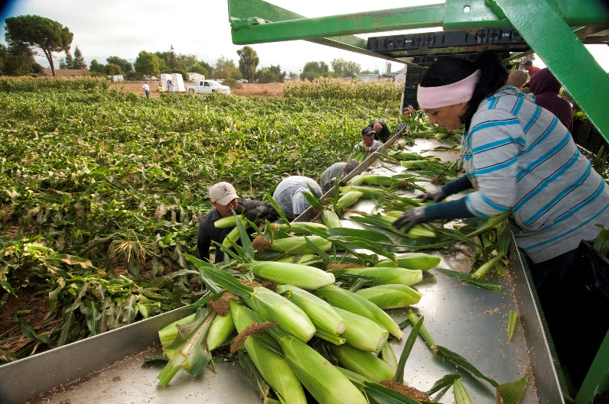
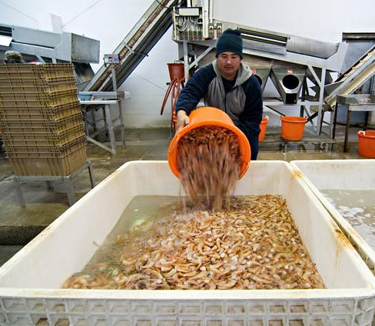
Who is eligible?
Farmworker or Fisher - worked in these temporary or seasonal industries

Slide 20
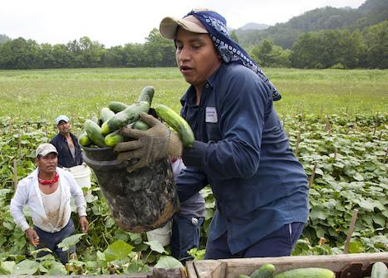
Who is eligible?
Eligible for Free Public Education in the US - students have not yet reached age 22 or obtained a HS diploma or equivalent
Ages 0-5 (PreK)
Grades K-12
Up to Age 22

Slide 21
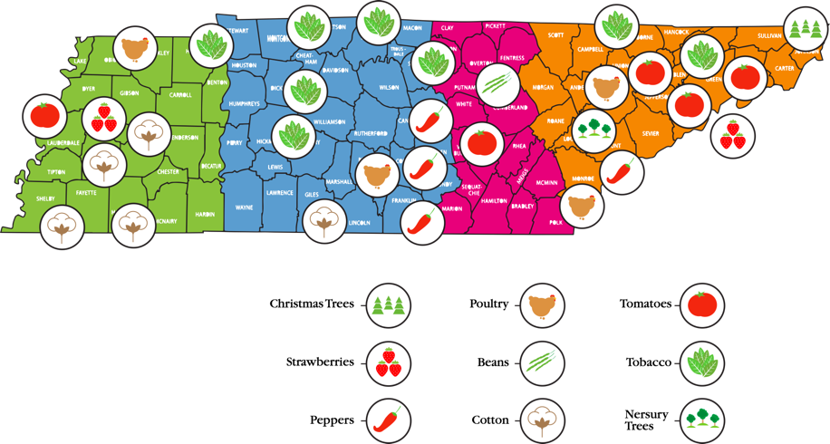
Regions & Qualifying Work
Resource from the Tennessee Migrant Student Profile. 2018-2019 data.

Slide 22
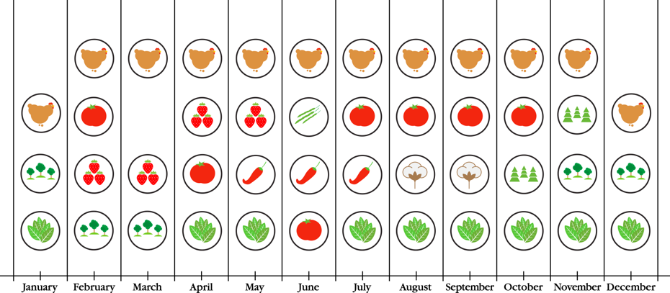
Qualifying Work
Resource from the Tennessee Migrant Student Profile. 2018-2019 data.

Slide 23
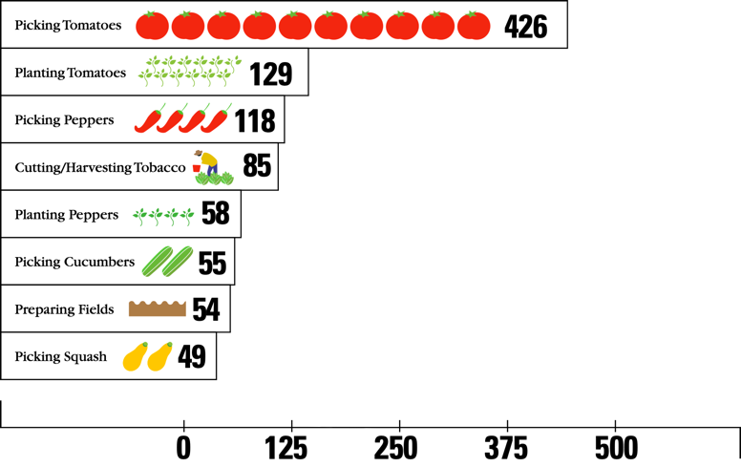
Qualifying Work
Resource from the Tennessee Migrant Student Profile. 2018-2019 data.

Slide 24
When do migratory students move?
Resource 2022-2023 COE data

Slide 25
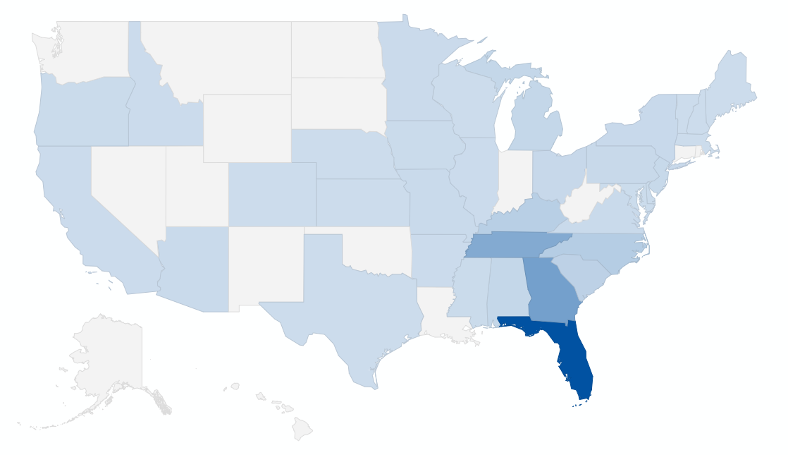
Where do migratory students move from?
From State | Students
FL | 1613
GA | 703
TN | 580
NC | 182
KY | 158
TX | 133
SC | 124
CA | 108
Resource from 2017-2021 COE Data

Slide 26
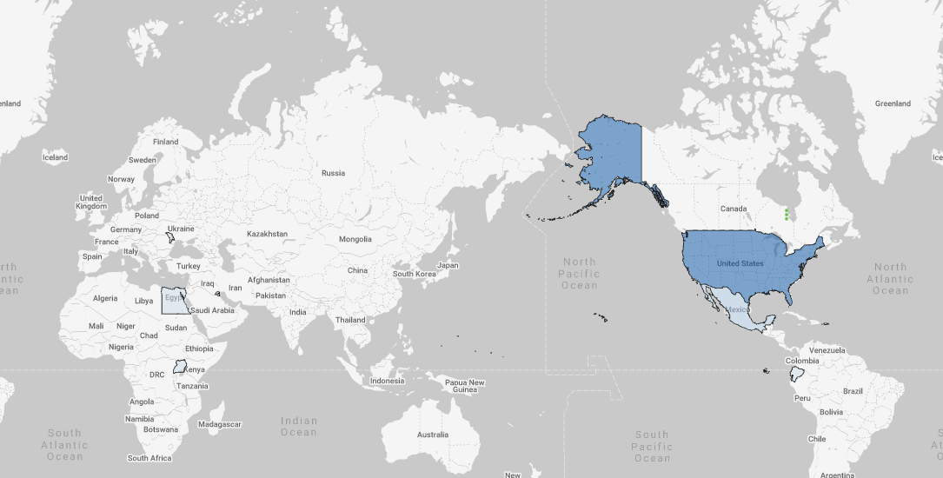
Where do migratory students move from?
From Country | Students
USA | 3774
MEX | 855
GUT | 384
HON | 31
UGA | 20
Resource from 2017-2021 COE Data

Slide 27
Where are migratory students in Tennessee?
LEA Name | No. of Students
Hamblen County | 148
Rhea County | 134
Bledsoe County | 116
Davidson County | 103
Shelby County | 53
Knox County | 45
Loudon County | 44
Grainger County | 42
Cocke County | 34
Bradley County | 24

Slide 28
Who are YOUR migratory students?
Thinking about YOUR students….
Where are they from originally?
Are they mostly K-12, preschool, or out-of-school youth?
What work do their parents do?
How long will they be with you?
What are their unique needs due to their migratory lifestyle?

Slide 29
How do we find our migratory students?

Slide 30
How do we find our migratory students?
Referral
Interview
Complete COE

Slide 31
How do we find our migratory students?
Following up on Occupational Surveys
Visiting farms, worksites, production plants etc.
Collaborating with community organizations
Getting out in the community!

Slide 32
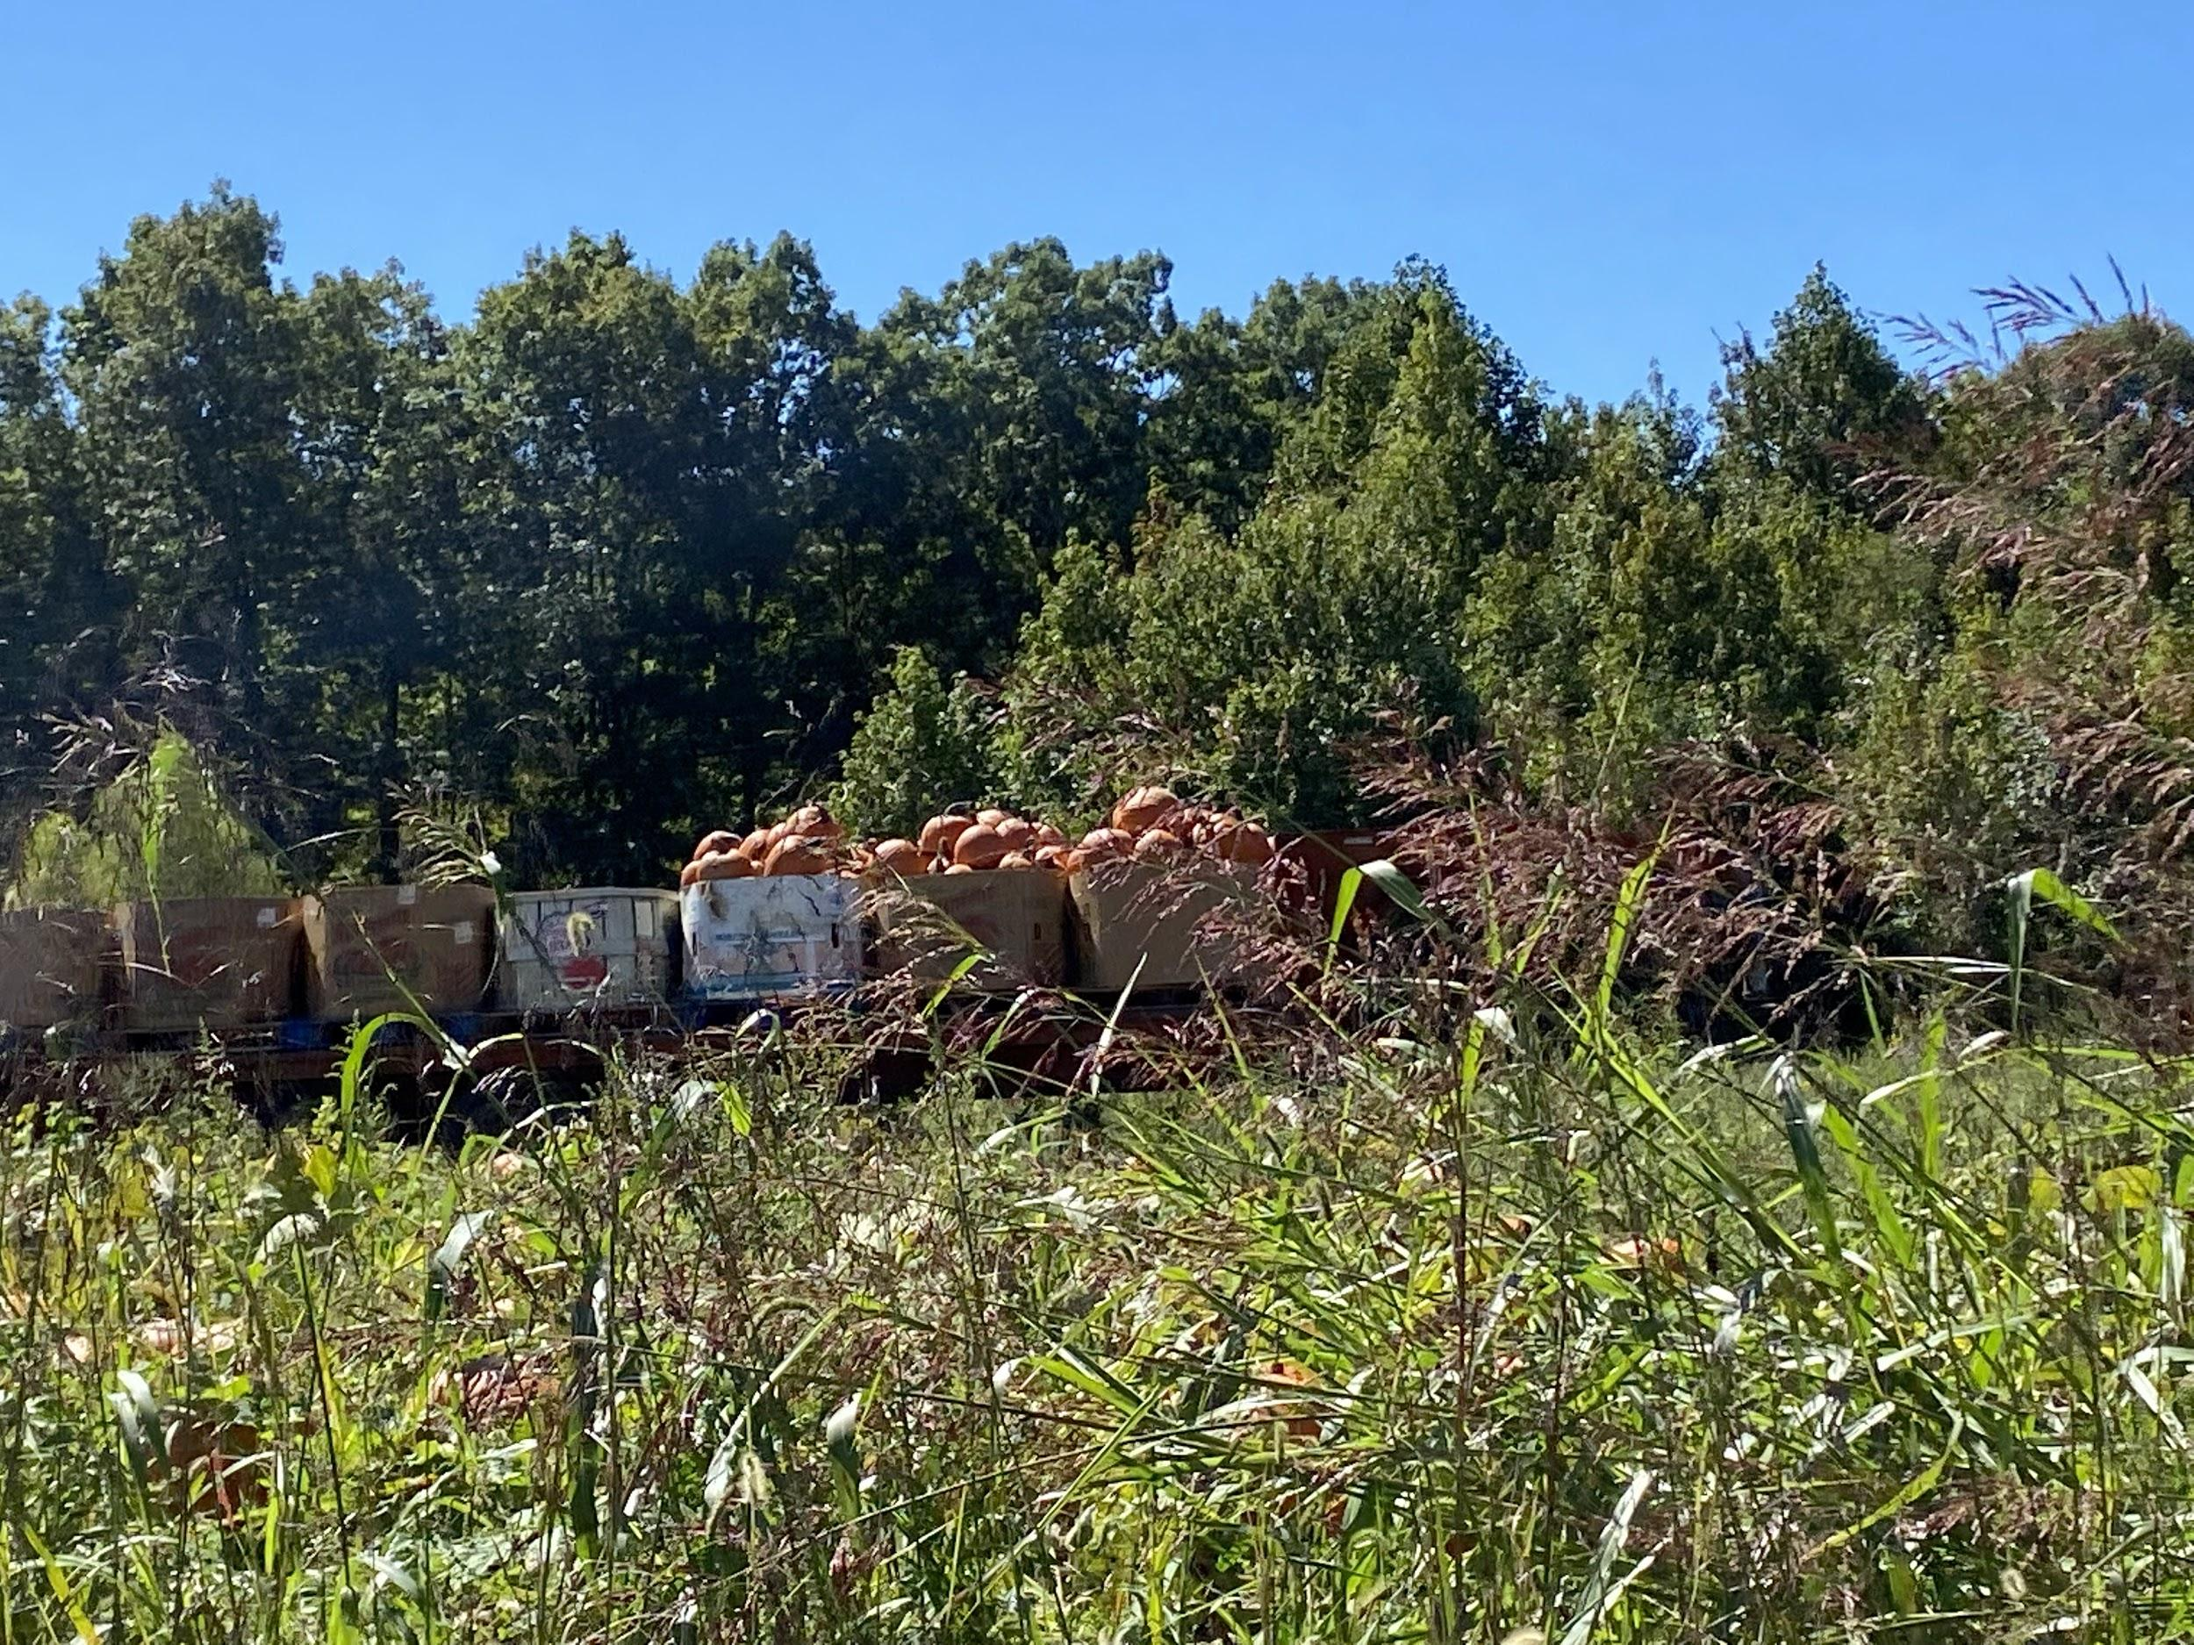
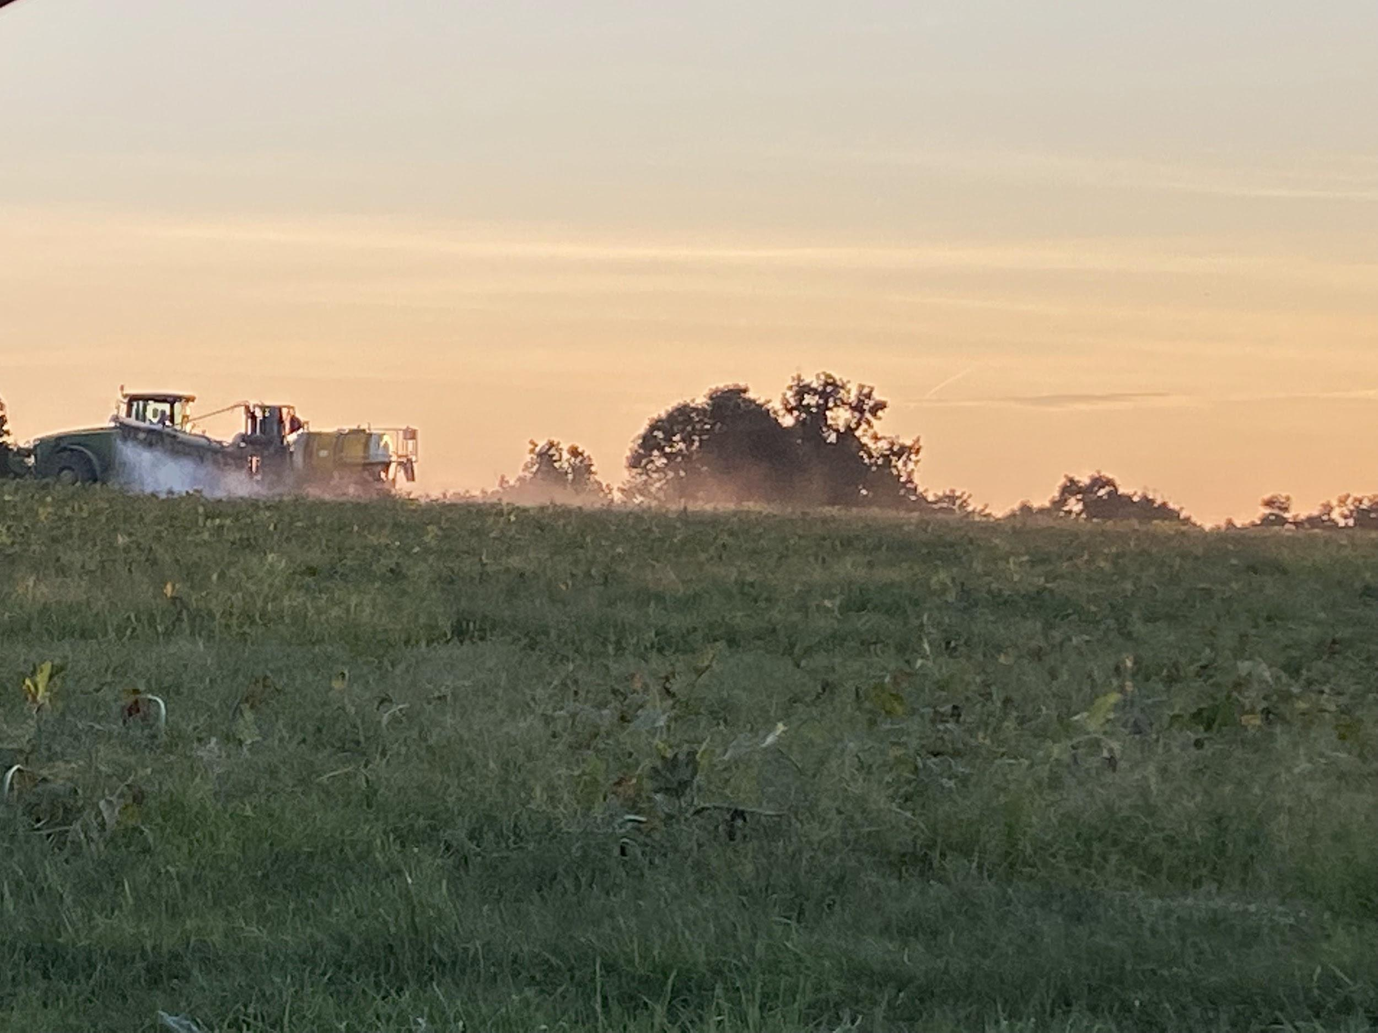
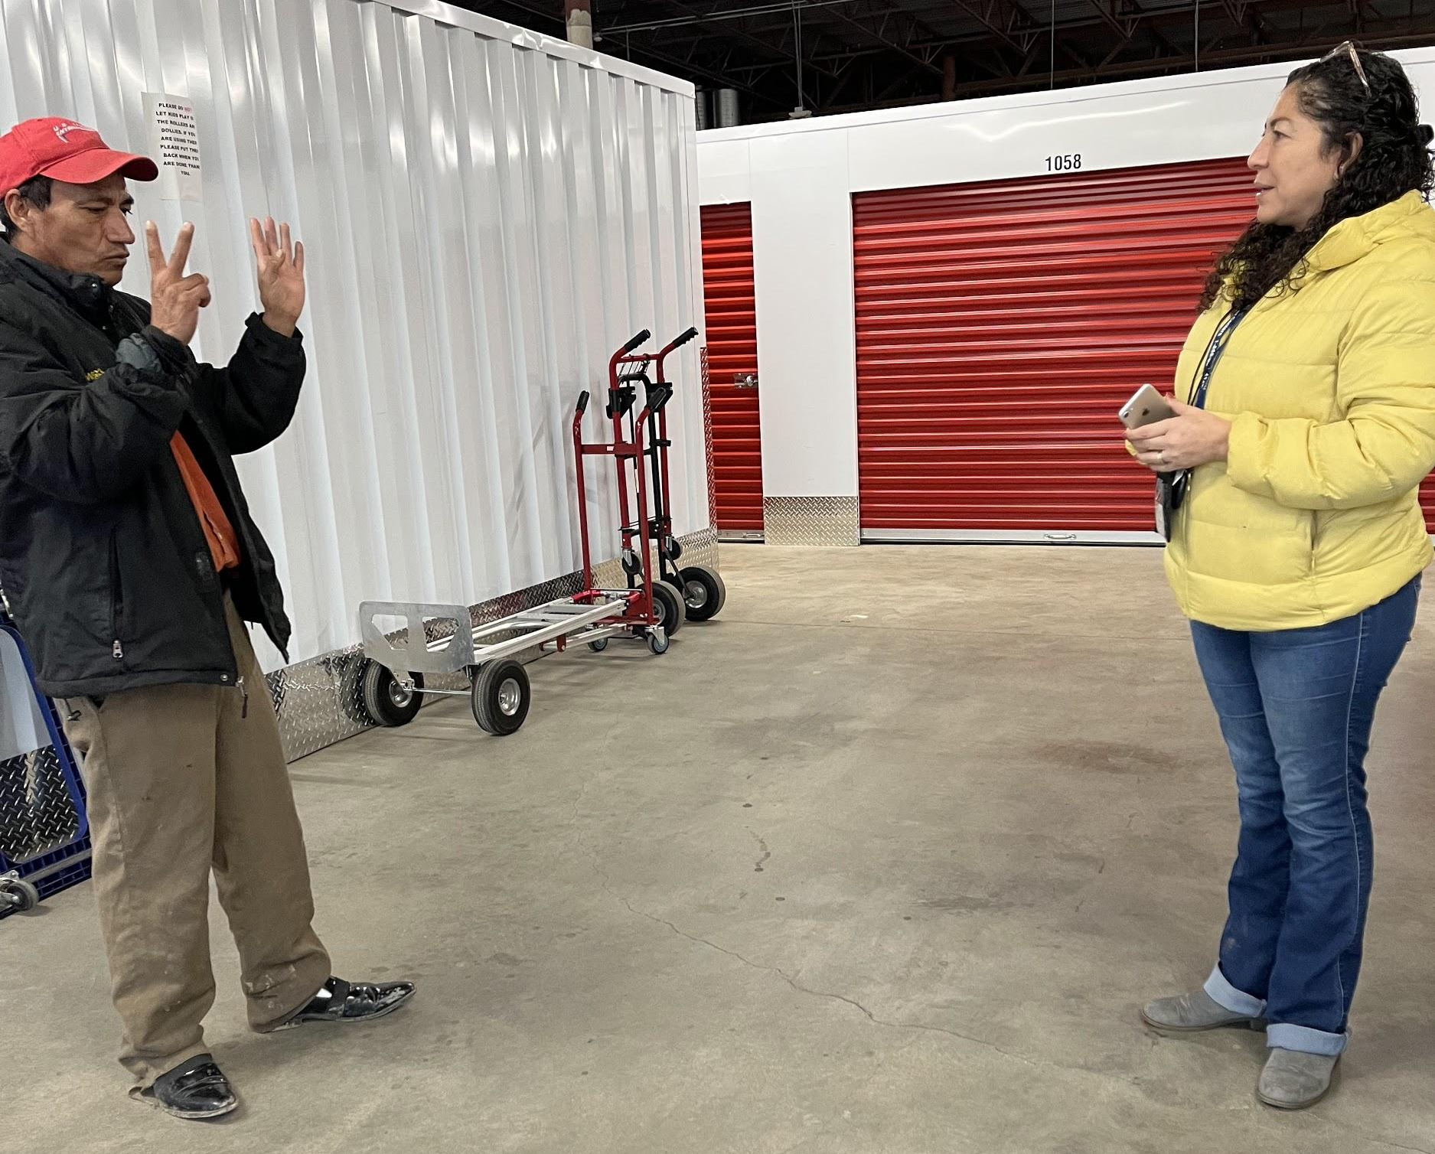
Recruitment in Action

Slide 33
How do we find our migratory students?
MSIX: Migrant Student Information Exchange
“Technology that allows States to share educational and health information on migrant children who travel from State to State”

Slide 34
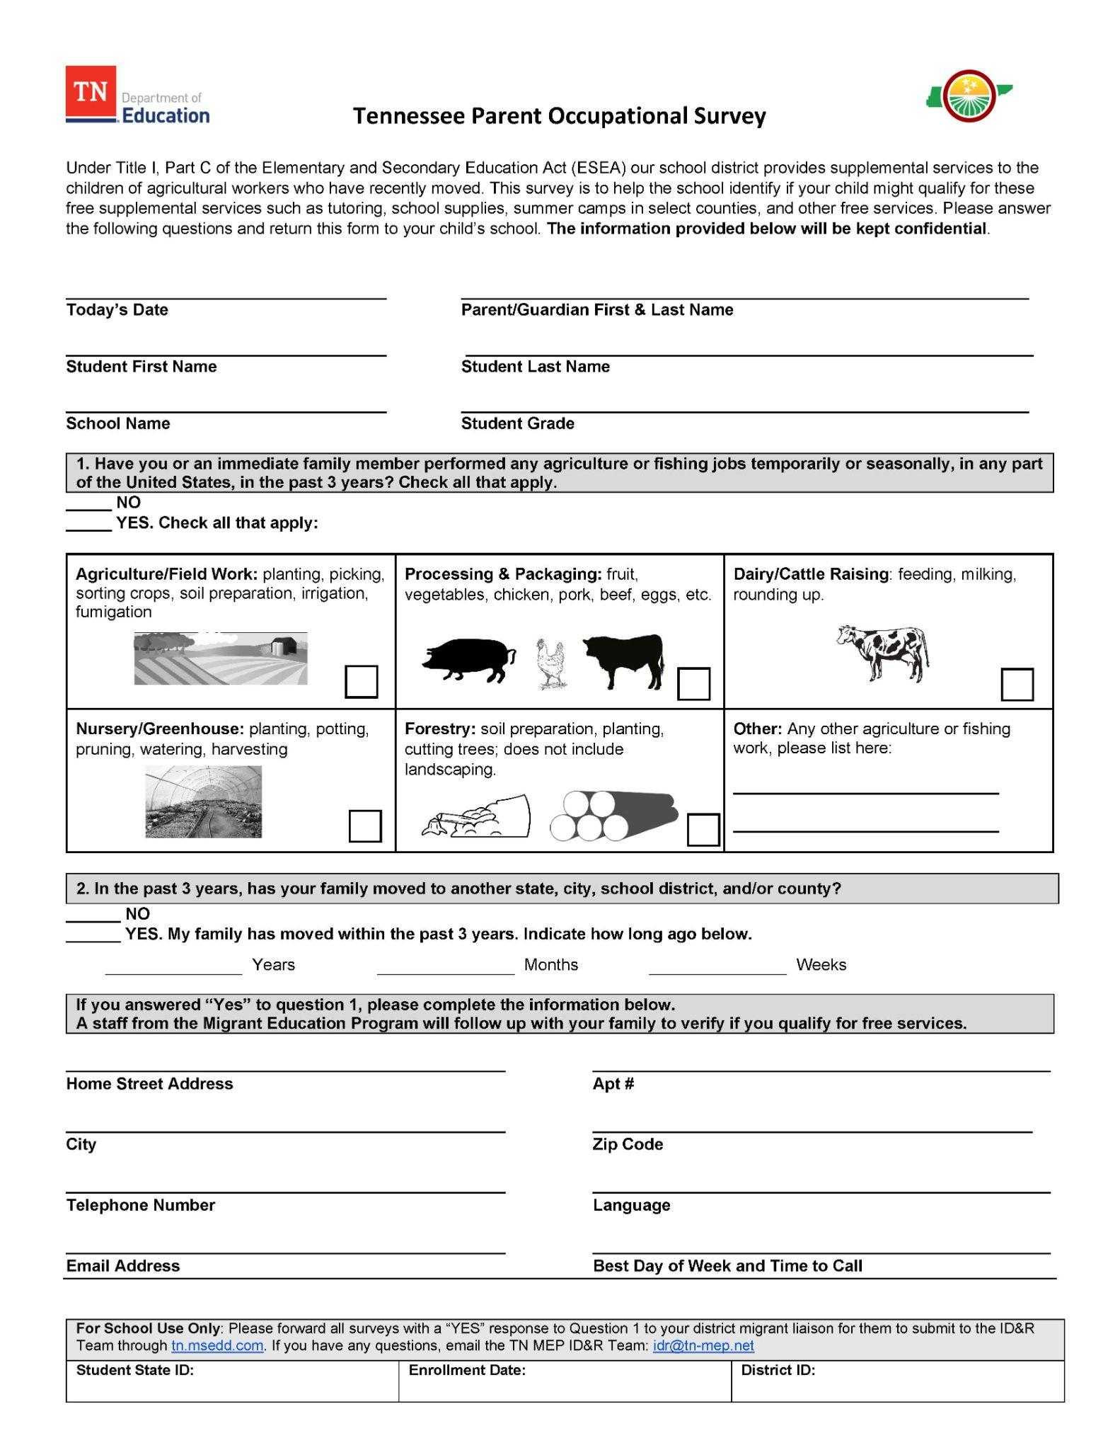
Migrant Occupational Survey

Slide 35
Occupational Surveys
Download the Surveys from the tn-mep.net website
Note: surveys are available in 12 languages
Place surveys in every student registration packet
Upload the forms with a “yes” to the first question to tn.msedd.com
The ID&R Team will follow up with the family to determine eligibility

Slide 36
Flyers & Brochures

Slide 37
Questions

Slide 38
Contact
Tennessee Migrant Education Program
https://www.tn-mep.net/
Matt Flaherty
(207) 632-9186
matt@arroyoresearchservices.com
Odilia Coffta
(585) 208-8555
odilia.coffta@arroyoresearchservices.com

